Slide 1


Social Buzz

Slide 2


Today's agenda
recap
Project problem
The Analytics team
Process
Insights
Summary

Slide 3

An
Social Buzz is a global unicorn technology company growing at an accelerated rate. Accenture has embarked in a 3 month work pilot to help tackle their biggest challenges which include:
Audit of Social Buzz Big data practice
Implementation of an IPO
Analysis of top 5 popular categories content
Project Recap

Slide 4

Problem
Social Buzz has reached over 100,000 posts per day which take us to 36,500,000 pieces of content per year!
But how do we capitalize on it when there is so much?

Slide 5



Andrew Fleming (Chief Technical Architect)
The Analytics team
Marcus Rompton (Senior Principle)
Sowmya Nataraj (Data Analyst)

Slide 6
Process
1
Data Understanding
2
Data Cleaning
3
Data Modeling
4
Data Analysis
5
Key Insights

Slide 7

Insights
There are total 13K posts in 2020 and 11 K in 2021
There are 16 categories where contents are posted
Posts with Photos are the highest in comparison to video/audio/Gif
Month of Jan 2021 a total of 2126 contents were posted which is Highest .
Animals ,Technology , science, culture and food are the top 5 content categories in terms of content posting and score
Positive sentiments are more for all type of contents
Top 5 categories contributes to ~40% of the posts.

Slide 8
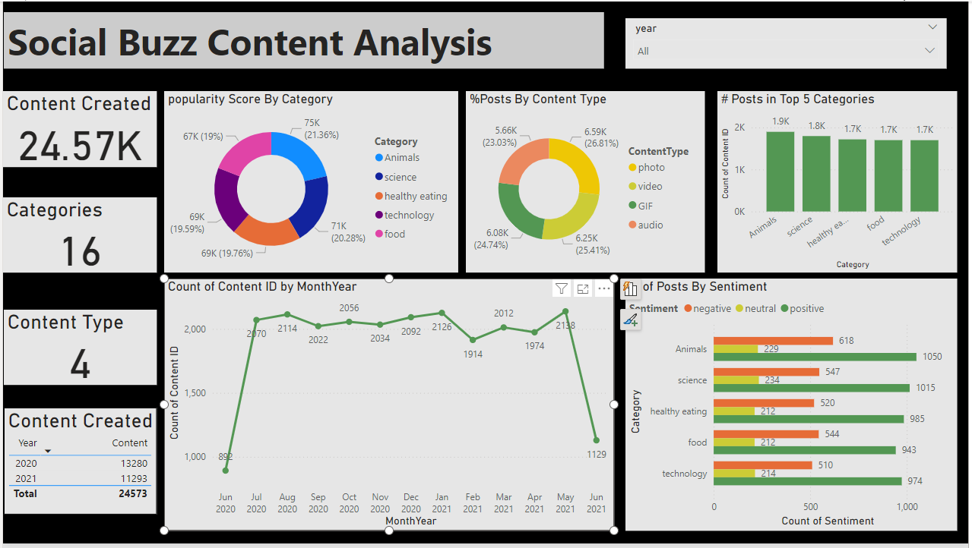

Slide 9
Steps Involved :
There where 3 csv files from social Buzz team . Which had the information about content posted ,reactions and types of reactions and corresponding scores
We started with data cleaning with the below steps
Removing unwanted columns like user id and url
Renaming some the columns with meaningful names
Removing empty rows
After data cleaning was done next step was to join the tables to bring the dataset to a single file with only required columns. Once the data got ready.
Power BI tool was chosen to build the visualizations

Slide 10

As a summary Social buzz is doing well in content creation. Focusing more on contents in the top 5 categories will get more attention from the users .
Summary

Slide 11
Thank you!
ANY QUESTIONS?

